Slide 1
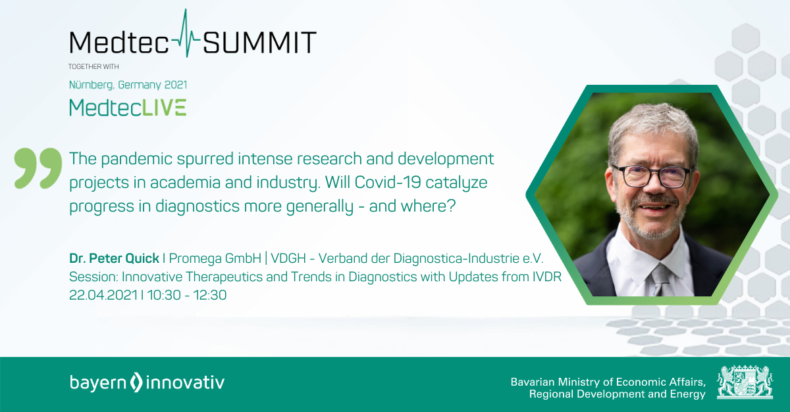
Covid-19 – An Accelerator for Diagnostics?
Dr. Peter Quick I Forum MedTech Pharma e.V.
Session: Innovative Therapeutics and Trends in Diagnostics with Updates from IVDR –

Slide 2
Covid-19 – An Accelerator for Diagnostics?
This title is a rhetoric question of course, at least since Nature Biotechnology judged already in July 2020 “By brutally exposing the shortcomings of existing diagnostic technologies and clinical testing infrastructure, COVID-19 is supercharging R&D efforts to establish novel testing approaches that are faster, simpler, cheaper and more scalable than existing methods, and just as accurate.” “Systems biology, nanobiotechnology, biophotonics and nanofluidic engineering are just some of the disciplines feeding into this broad effort.”
But how can we see where these efforts are going and impacting diagnostic issues beyond COVID-19? And what to expect from the European arena?
Dr. Peter Quick I Forum MedTech Pharma e.V.
Session: Innovative Therapeutics and Trends in Diagnostics with Updates from IVDR –

Slide 3
Covid-19 – An Accelerator for Diagnostics?
According to the OECD, the SARS-CoV-2 pandemic has mobilized scientific research and cooperation in an unprecedented manner. In the first few months of the pandemic alone, national research funding institutions around the world urgently provided around 4.1 billion euros for R&D on COVID-19.
About 700 million euros of this came from Europe.
423 million euros of this for 846 projects can be tracked in detail for the eight European countries (AT, CH, DE, Fr, HU, PL, SK, UK), including the contact details of the funding recipients:
Source: FundFinder 42
Dr. Thomas Hoffmann
thoffmann@42-heidelberg.de
+49 6221 484243
0172 - 622 44 67
Dr. Peter Quick I Forum MedTech Pharma e.V.
Session: Innovative Therapeutics and Trends in Diagnostics with Updates from IVDR –

Slide 4
Ausschuss Marktforschung der FA LSR
49%: Academic Research

Slide 5
Covid-19 – An Accelerator for Diagnostics?
Revenue (€) LSR products to research institutions in Germany | CJ 2019 Share in %
academic research | 49,3%
pharmaceutical companies | 13,0%
analytical service companies/diagnostics | 12,9%
biotechnology | 9,2%
public authorities/non-profit organizations | 9,0%
industry | 6,5%
Dr. Peter Quick I Forum MedTech Pharma e.V.
Session: Innovative Therapeutics and Trends in Diagnostics with Updates from IVDR –

Slide 6
Covid-19 – An Accelerator for Diagnostics?
When Nobel price inventions like CRISPR CAS-9 happen, this is the creative field where innovation takes place. Academic scientists inspire the LSR industry, and LSR companies develop tangible tools for scientists (in all LS segments) to use such invention in their experiments. Further development of these tools lead to applied science solutions.
Dr. Peter Quick I Forum MedTech Pharma e.V.
Session: Innovative Therapeutics and Trends in Diagnostics with Updates from IVDR –

Slide 7
Covid-19 – An Accelerator for Diagnostics?
Applied Research, examples:
DNA fingerprinting in forensics,
Laboratory diagnostics,
Wastewater Biomonitoring
Dr. Peter Quick I Forum MedTech Pharma e.V.
Session: Innovative Therapeutics and Trends in Diagnostics with Updates from IVDR –

Slide 8
Covid-19 – An Accelerator for Diagnostics?
LSR BioResearch Companies, ranked by BioResearch Bus Value
ThermoFisher
Danaher Corp. incl. GE Healthcare
Merck Life Sciences
Illumina
Agilent
Bio Rad Laboratories
Becton Dickinson
Perkin Elmer
Qiagen
Biotechne
Promega
Luminex
Pacific Biosciences
Roche Applied (part of IVD)
Source: ABA analysis of published company reports
Dr. Peter Quick I Forum MedTech Pharma e.V.
Session: Innovative Therapeutics and Trends in Diagnostics with Updates from IVDR –

Slide 9
Covid-19 – An Accelerator for Diagnostics?
Dr. Peter Quick I Forum MedTech Pharma e.V.
Session: Innovative Therapeutics and Trends in Diagnostics with Updates from IVDR –

Slide 10
Covid-19 – An Accelerator for Diagnostics?
Dr. Peter Quick I Forum MedTech Pharma e.V.
Session: Innovative Therapeutics and Trends in Diagnostics with Updates from IVDR –

Slide 11
Covid-19 – An Accelerator for Diagnostics?
Dr. Peter Quick I Forum MedTech Pharma e.V.
Session: Innovative Therapeutics and Trends in Diagnostics with Updates from IVDR –

Slide 12
Covid-19 – An Accelerator for Diagnostics?
LSR and IVD industry increase production 18 times within 4 months!
Corona-associated products: Reagents, Proteins, Testkits, Instruments, Extraction kits, Swabs, Pipette tips etc.
Dr. Peter Quick I Forum MedTech Pharma e.V.
Session: Innovative Therapeutics and Trends in Diagnostics with Updates from IVDR –

Slide 13

Covid-19 – An Accelerator for Diagnostics?
915 COVID-19 related R&D projects were funded by tax money in Europe, i.e. AT, CH, DE, Fr, HU, PL, SK, and UK, at Feb end 2021.
Dr. Peter Quick I Forum MedTech Pharma e.V.
Session: Innovative Therapeutics and Trends in Diagnostics with Updates from IVDR –

Slide 14
Covid-19 – An Accelerator for Diagnostics?
95 of these 915 projects are related to diagnostics.
Dr. Peter Quick I Forum MedTech Pharma e.V.
Session: Innovative Therapeutics and Trends in Diagnostics with Updates from IVDR –

Slide 15
Covid-19 – An Accelerator for Diagnostics?
~ 70 of these projects highlight innovative aspects, and the respective project summaries got reviewed in more detail.

Slide 16
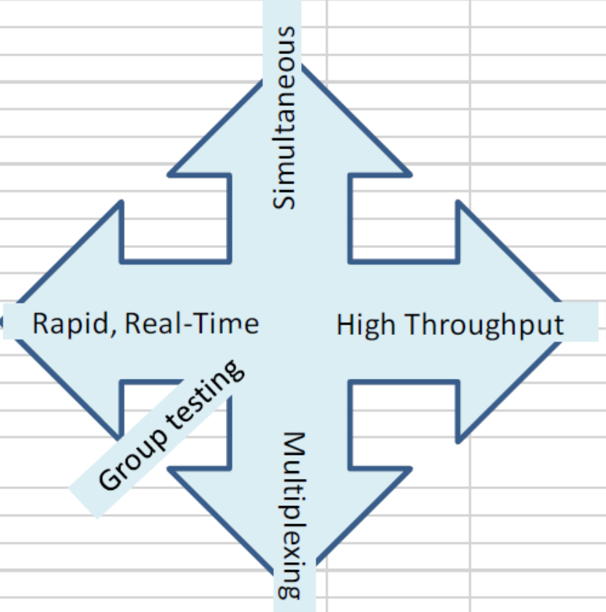
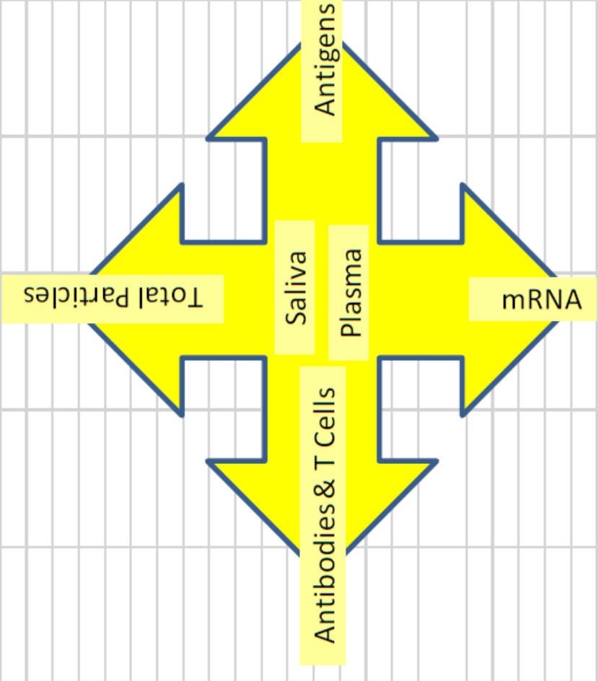
Covid-19 – An Accelerator for Diagnostics?
Conceptual rotation / interaction of hub and spokes wheels
Dr. Peter Quick I Forum MedTech Pharma e.V.
Session: Innovative Therapeutics and Trends in Diagnostics with Updates from IVDR –

Slide 17
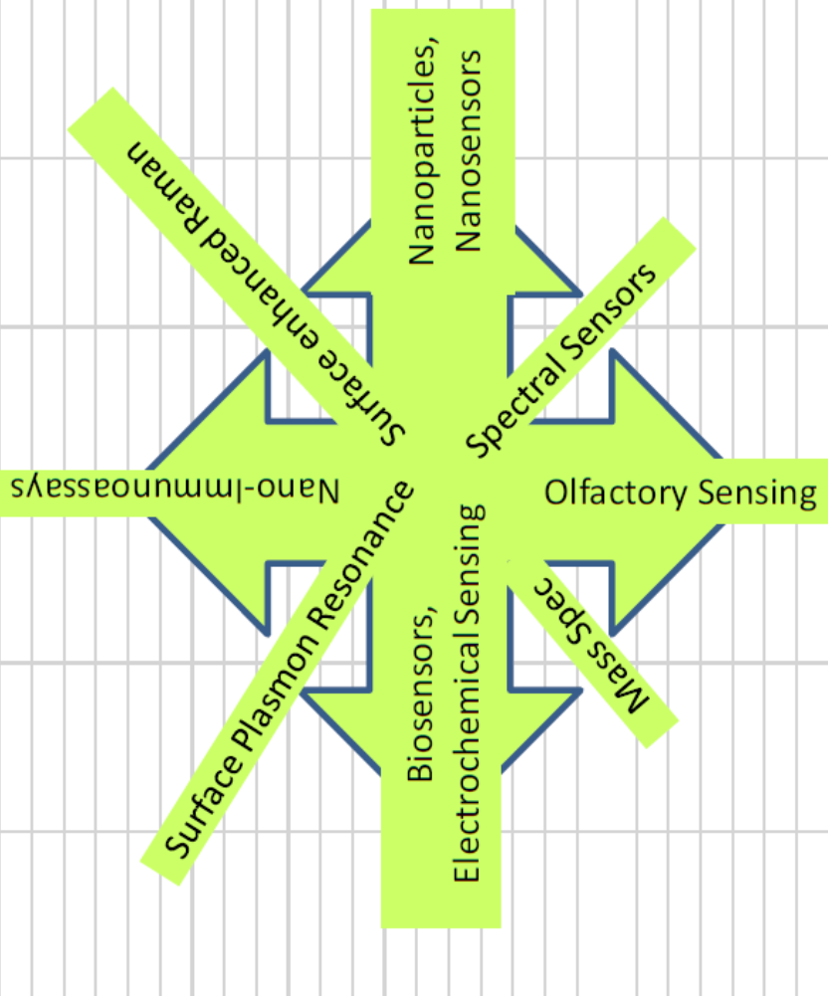
Covid-19 – An Accelerator for Diagnostics?
Conceptual rotation / interaction of hub and spoke wheels
61 innovative projects:
20: Serology
14: (Bio) Sensing
14: other Rapid test solutions
13: Risk Prevention
Dr. Peter Quick I Forum MedTech Pharma e.V.
Session: Innovative Therapeutics and Trends in Diagnostics with Updates from IVDR –

Slide 18
Covid-19 – An Accelerator for Diagnostics? YES!
Genius5-Instruments GmbH (AT): Rapid detection of the coronavirus in travel with an odor test
80% of Covid-19 patients with mild or moderate infection lose their sense of smell. The aim is a measuring device that detects these partly undiscovered virus emitters by measuring the olfactory sense at the odor threshold. The odor test is advantageously inexpensive and fast, it is suitable for testing large numbers of people in order to reduce the risk of infection in tourism and at events.
Genius5-Instruments GmbH (AT), Dipl. Ing. Dr. Gerhard Kahr: A new study was submitted in elementary schools and sports middle schools, which includes children between the ages of 5 and 15, with the aim of proving sensitivities better than 97% in this age group for use in schools in the next school year. Anosmia resp. odor disorder is the main symptom in children, 90% of children with proven odor disorder have Covid-19. By systematic use of the odor tester, "sudden olfactory disturbance" is detected earlier - reduction of the asymptomatically infected. High acceptance of the odor test by children, as it is contact-free!
Dr. Peter Quick I Forum MedTech Pharma e.V.
Session: Innovative Therapeutics and Trends in Diagnostics with Updates from IVDR –

Slide 19
Covid-19 – An Accelerator for Diagnostics? YES!
ETH Zürich - Biosysteme und Ingenieurwissenschaften (CH): Large-scale testing and tracking of SARS-CoV-2 infection and evolution by deep sequencing. Development of a molecular barcoding method to tag individual patient RNA samples, which will then be highly multiplexed and tested for detection of virus by deep sequencing and bioinformatics. The molecular barcodes will be connected to a patient identification sample, meaning that on a single deep sequencing run (e.g., Illumina MiSeq) we will be able to multiplex and test up to 4,800 patient samples (Aim 1).
Dr. Peter Quick I Forum MedTech Pharma e.V.
Session: Innovative Therapeutics and Trends in Diagnostics with Updates from IVDR –

Slide 20
Covid-19 – An Accelerator for Diagnostics? YES!
Senova Greenlight, based on ams AG (AT), and its spectral sensor AS7341L: The digital rapid test with integrated quality control, the further development of the LFT.
The first digital rapid test for the detection of SARS-CoV-2 antigens in a smear from the nasopharynx or human antibodies against SARS-CoV-2 in blood, serum or plasma.
Thanks to its networked platform (dLFA quick test cassette, app and cloud), it enables up to 30 tests to be carried out independently. The digital evaluation of the tests makes it possible to get laboratory-quality test results within just a few minutes.
It can capture all sample-specific data such as clinical data, ICD-10 codes, answers to a questionnaire, check boxes, IDs, sample barcodes, text, images, etc. and save it in the cloud for individual testing so that it cannot be confused.
It can add the corresponding geodata at the time of the measurement to all tests.
Senova Greenlight, based on ams AG (AT), Dr. Thomas Stockmeier, CTO ams AG: “The digital rapid test (initially for professional use) is sold by the company Senova in Weimar. There is a test cassette for antigen as well as for antibodies.
Another immuno test for antibodies for S and N protein (i.e., vaccination and survived infection) should be approved in 1-2 weeks.
The next development steps are a test based on fluorescence, which will be 10 x more sensitive, as well as home use, and a flat nasal swab. It all happens before summer.”
Dr. Peter Quick I Forum MedTech Pharma e.V.
Session: Innovative Therapeutics and Trends in Diagnostics with Updates from IVDR –

Slide 21
Covid-19 – An Accelerator for Diagnostics? YES!
Elisha Systems Limited (UK): Affinity Biosensors for COVID-19 Antibodies. Tim Gibson states that the sensitivity is now down to an equivalent of 500 virus particles, and that they are progressing with a proto-type handheld device similar to blood glucose systems, but with an impedance-sensing ultrathin microchip, and coupled to a mobile phone. Plans for manufacturing develop, and this solution concept would work for any assay related to antibodies, far beyond COVID-19.
Elisha Systems Limited (UK): Affinity Biosensors for COVID-19 Antibodies. With affinity reagents linked to electronic surfaces, it is now possible to produce biosensors to any protein. Affinity reagents bind proteins like antibodies or virus antigens very tightly thereby making the tests being developed absolutely specific to the target. The whole system is future proofed, because it will be possible to change the specificity of the biosensors by changing the affinity reagent used. Therefore, if a different virus appears, proteins and antibodies associated with any new virus can be detected by making a different biosensor with different reagents to change the specificity.
Dr. Peter Quick I Forum MedTech Pharma e.V.
Session: Innovative Therapeutics and Trends in Diagnostics with Updates from IVDR –

Slide 22
Covid-19 – An Accelerator for Diagnostics? YES!
École Polytechnique Fédérale de Lausanne (EPFL) - Institut de Bioingénierie - Laboratoire de caractérisation du réseau biologique - EPFL STI IBI-STI LBNC (CH): Large-scale serological profiling of SARS-CoV-2 …with high-throughput microfluidic nano-immunoassays
Em Scientific Limited (UK): Two rapidly scalable, differentiated, and validated COVID-19/SARS-CoV-2 antibody tests for mass-testing. Development of targeted mass spectrometry antibody tests for mass-testing and vaccine development.
Universität Tübingen - Fakultät für Biologie - Interfakultäres Institut für Zellbiologie – Molekularbiologie (DEU): SARS-CoV-2-T-Zell-Epitope für die Entwicklung neuer diagnostischer und therapeutischer Ansätze für die COVID-19-Krankheit
GNA Biosolutions GmbH (DE): A miniaturized disposable molecular diagnostics platform for combatting coronavirus infections (DECISION). The platform is powered by a next-generation nucleic acid amplification technology called Pulse Controlled Amplification (PCA®), which enables sample-to-answer workflows in 15 minutes or less.
GB Electronics Limited (UK): Rapid Point-of-Care Diagnostic Device for COVID-19: Low-cost and portable molecular diagnostic platform. With some modification it could use a Loop Mediated Isothermal Amplification (LAMP) assay to detect COVID-19 directly from a patient sample (nasal or throat swabs) within 30 minutes.
International Institute of Molecular and Cell Biology (IIMCB) - Laboratory of Structural Biology (PL): Rapid and operationally simple SARS-CoV-2 tests using CRISPR tools (“do it at home by yourself” test). The qPCR reaction that requires complicated equipment can be replaced by nucleic acid amplification at a constant temperature, however, at the price of much lower efficiency. The lower efficiency, in turn, can be compensated for by an additional nucleic acid amplification step using an enzyme, called Cas13.
Dr. Peter Quick I Forum MedTech Pharma e.V.
Session: Innovative Therapeutics and Trends in Diagnostics with Updates from IVDR –

Slide 23
Covid-19 – An Accelerator for Diagnostics? YES!
École Polytechnique Fédérale de Lausanne (EPFL) - Institut de Bioingénierie - Laboratoire de caractérisation du réseau biologique - EPFL STI IBI-STI LBNC (CH): Large-scale serological profiling of SARS-CoV-2 …with high-throughput microfluidic nano-immunoassays
Dr. Sebastian Josef Maerkl: “We developed a microfluidic nano-immunoassay for the detection of anti-SARS-CoV-2 IgG antibodies in 1024 samples per device. The method achieved a specificity of 100% and a sensitivity of 98% based on the analysis of 289 human serum samples.
To eliminate the need for venipuncture, we developed low-cost, ultra-low volume whole blood sampling methods based on two commercial devices and repurposed a blood glucose test strip. The glucose test strip permits the collection, shipment, and analysis of 0.6 µL whole blood easily obtainable from a simple fingerprick.
The nano-immunoassay platform achieves high-throughput, high sensitivity and specificity, negligible reagent consumption, and a decentralized and simple approach to blood sample collection. We expect this technology to be immediately applicable to current and future SARS-CoV-2 related serological studies and to protein biomarker diagnostics in general.”
This is cited from a preprint at medRxiv, and the article should be out on PNAS by now.
Dr. Peter Quick I Forum MedTech Pharma e.V.
Session: Innovative Therapeutics and Trends in Diagnostics with Updates from IVDR –

Slide 24
Covid-19 – An Accelerator for Diagnostics? YES!
Identification of Risk factors; Prognostics, Stratification
Sepsis / AMR < 2 hours | Oxford Medistress Ltd.: Leukocyte ImmunoTest (LIT)
Coagulation
Coagulation | Special diagnostics
Coagulation | TGA-TM: Thrombomodulin-modifying Thrombin-generation test
Genetic Risk Factors
ABO bloodgroup status
HLA = human leucocyte antigen system
MHC = Major histocompatibility complex | Development of algorithm for stratification
Circulating microvesicle profiles | Identification of inflammation markers
Cytokine storm / Immune response
Human susceptibility genes - SNPs in the innate immune pathway
Senseutics Ltd. : "Cytokine Storm Tracker"
HTP, high-dimensional single cell profiling, to map the immune response
Ludger Ltd.: GlyHealth test to identify ImmunoFrail patients
Impact of activity of the Renin-Angiotensin-Aldosteron System
Intestinal mictobiome as a factor
Development of novel algorithm-driven digital platform for assessing the Leukocyte ImmunoTest™ as a clinical parameter in monitoring vulnerability to coronavirus. The advanced Leukocyte ImmunoTest (LIT)™ is a rapid (10-minute) fingerprick in vitro blood test to assess how well an individual's immune system is functioning. The team hopes to demonstrate the potential for the technique for providing an early-warning indicator of poor immune function for frontline NHS healthcare workers in order to determine who is at greatest risk of contracting coronavirus.
Dr. David Sarphie at Oxford Medistress Ltd: “Our LIT-Sepsis project is going extremely well and our recent data demonstrates that neutrophil activity (as measured by the LIT) significantly increases (by at least an order of magnitude) for sepsis patients in the ICU (as well as for COVID-ICU patients).
We have almost finished drafting a paper on this study with Prof Paul Moss of the Queen Elizabeth Hospital- Birmingham.”
Dr. Peter Quick I Forum MedTech Pharma e.V.
Session: Innovative Therapeutics and Trends in Diagnostics with Updates from IVDR –

Slide 25
Covid-19 – An Accelerator for Diagnostics? YES!
Identification of Risk factors; Prognostics, Stratification
Sepsis / AMR < 2 hours | Oxford Medistress Ltd.: Leukocyte ImmunoTest (LIT)
Coagulation
Coagulation | Special diagnostics
Coagulation | TGA-TM: Thrombomodulin-modifying Thrombin-generation test
Genetic Risk Factors
ABO bloodgroup status
HLA = human leucocyte antigen system
MHC = Major histocompatibility complex | Development of algorithm for stratification
Circulating microvesicle profiles | Identification of inflammation markers
Cytokine storm / Immune response
Human susceptibility genes - SNPs in the innate immune pathway
Senseutics Ltd. : "Cytokine Storm Tracker"
HTP, high-dimensional single cell profiling, to map the immune response
Ludger Ltd.: GlyHealth test to identify ImmunoFrail patients
Impact of activity of the Renin-Angiotensin-Aldosteron System
Intestinal mictobiome as a factor
Let me put a final highlight on GlyHealth, a test platform to identify ImmunoFrail patients. The companies AVENNA and Ludger ltd are cooperating with the OXFORD Translational Gastroenterology Unit to test the status of patients with Inflammatory Bowel Disease, applying MS protocols for Glycomic Analysis from 200 ul blood samples. The principles of the GlyHealth-IBD test for disease prognosis and prediction of need for treatment escalation for newly diagnosed IBD patients can be translated to identify individuals who would be vulnerable to inflammatory storms from COVID-19 and / or potential non-responders to SARS-CoV-2 vaccines – we’ll watch their progress in 2021!
Dr. Peter Quick I Forum MedTech Pharma e.V.
Session: Innovative Therapeutics and Trends in Diagnostics with Updates from IVDR –

Slide 26
Covid-19 – An Accelerator for Diagnostics?
Questions?
If you want to get the fund finder files selected for a) diagnostics or b) for drug screening (i.e. therapeutic research) just drop me an e-mail: peter.quick@promega.com
Thanks for your attention!
Dr. Peter Quick I Forum MedTech Pharma e.V.
Session: Innovative Therapeutics and Trends in Diagnostics with Updates from IVDR –

Slide 27
Covid-19 – An Accelerator for Diagnostics!
Abbreviations, Acronyms
Aptamers: short single-stranded DNA or RNA oligonucleotides (25–70 bases) or peptides that can bind a specific molecule via their 3D structure. If the aptamer is a peptide, it is called a peptide aptamer.
ARDS: acute respiratory distress syndrome
AuNIs: gold nano-islands
DC resistance: direct current resistance
LFT: lateral flow test
LIT™: Leukocyte Immuno Test
LOD: limits of detection
LAMP: Loop Mediated Isothermal Amplification assay
LSPR: localized surface plasmon resonance
MHC: Major histocompatibility complex
Nested PCR: a modification of polymerase chain reaction intended to reduce non-specific binding to the amplification of unexpected primer binding sites
PBG: functional peptide binding groove
PNPs: protein-based nanoparticles
PCA®: Pulse Controlled Amplification
SNPs: single nucleotide polymorphism
TGA-TM: Thrombomodulin-modified thrombin generation test
VLPs: Virus-Like Particles
Dr. Peter Quick I Forum MedTech Pharma e.V.
Session: Innovative Therapeutics and Trends in Diagnostics with Updates from IVDR –

